Slide 1
Course Title
Operating Systems & Systems Programming
Course No.
CSE - 3201 / CSE - 2205

Slide 2
Operating Systems & Systems Programming
Deadlock
Deadlock can be defined formally as follows:
A set of processes is deadlocked if each process in the set is waiting for an event that only another process in the set can cause.

Slide 3
Operating Systems & Systems Programming
Deadlock
Deadlock can be defined formally as follows:
A set of processes is deadlocked if each process in the set is waiting for an event that only another process in the set can cause.

Slide 4
Operating Systems & Systems Programming
Deadlock
Conditions for Resource Deadlocks
Coffman et al. (1971) showed that four conditions must hold for there to be a (resource) deadlock:
Mutual exclusion condition. Each resource is either currently assigned to exactly one process or is available.
Hold-and-wait condition. Processes currently holding resources that were granted earlier can request new resources
No-preemption condition. Resources previously granted cannot be forcibly taken away from a process. They must be explicitly released by the process holding them
Circular wait condition. There must be a circular list of two or more processes, each of which is waiting for a resource held by the next member of the chain.

Slide 5
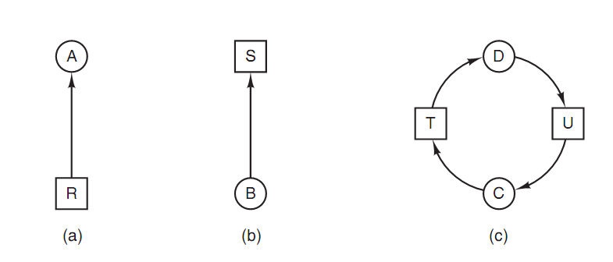
Operating Systems & Systems Programming
Deadlock
Deadlock Modeling
The sequence of events required to use a resource is given below.
1. Request the resource. 2. Use the resource. 3. Release the resource.
Figure . Resource allocation graphs. (a) Holding a resource. (b) Requesting
a resource. (c) Deadlock.

Slide 6
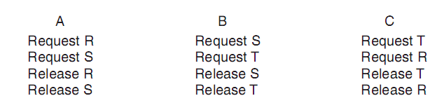
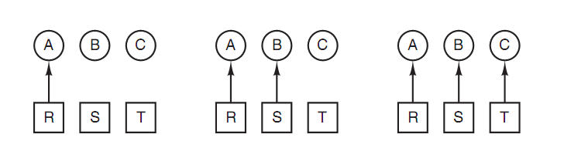
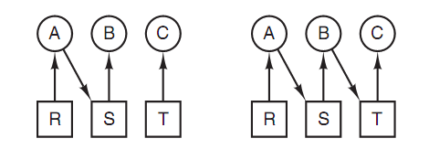
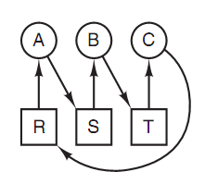
Operating Systems & Systems Programming
Deadlock : how deadlock occurs
A requests R B requests S C requests T
A requests S B requests T C requests R
deadlock

Slide 7
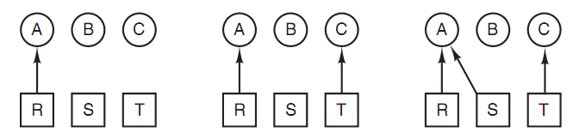
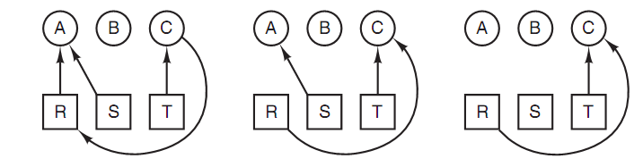
Operating Systems & Systems Programming
Deadlock : how deadlock can be avoided
A requests R C requests T A requests S
C requests R A releases R A releases S

Slide 8
Operating Systems & Systems Programming
Deadlock
In general, four strategies are used for dealing with deadlocks.
Just ignore the problem. Maybe if you ignore it, it will ignore you.
Detection and recovery. Let them occur, detect them, and take action.
Dynamic avoidance by careful resource allocation.
Prevention, by structurally negating one of the four conditions.

Slide 9
Operating Systems & Systems Programming
Deadlock
Deadlock Detection with One Resource of Each Type
Example
1. Process A holds R and wants S.
2. Process B holds nothing but wants T.
3. Process C holds nothing but wants S.
4. Process D holds U and wants S and T.
5. Process E holds T and wants V.
6. Process F holds W and wants S.
7. Process G holds V and wants U.
The question is: "Is this system deadlocked, and if so, which processes are involved?"

Slide 10
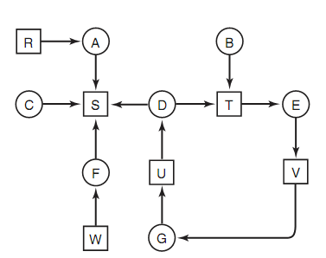
Operating Systems & Systems Programming
Deadlock
To answer this question, we can construct the resource graph as of Figure below:

Slide 11
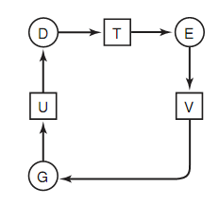
Operating Systems & Systems Programming
Deadlock
This graph contains one cycle, which can be seen by visual inspection. The cycle is shown in Figure below:

Slide 12
Operating Systems & Systems Programming
Deadlock
From this cycle, we can see that processes D, E, and G are all deadlocked. Processes A, C, and F are not deadlock because S can be allocated to any one of them, which then finishes and returns it. Then the other two can take it in turn and also complete.

Slide 13
Operating Systems & Systems Programming
Deadlock
Many algorithms for detecting cycles in directed graphs are known. Below we will give a simple one that inspects a graph and terminates either when it has found a cycle or when it has shown that none exists.
It uses one dynamic data structure, L, a list of nodes, as well as a list of arcs. During the algorithm, to prevent repeated inspections, arcs will be marked to indicate that they have already been inspected.

Slide 14
Operating Systems & Systems Programming
Deadlock
The algorithm operates by carrying out the following steps as specified:
1. For each node, N in the graph, perform the following five steps with N as the starting node.
2. Initialize L to the empty list, and designate all the arcs as unmarked.
3. Add the current node to the end of L and check to see if the node now appears in L two times. If it does, the graph contains a cycle (listed in L) and the algorithm terminates.
4. From the given node, see if there are any unmarked outgoing arcs. If so, go to step 5; if not, go to step 6.

Slide 15
Operating Systems & Systems Programming
Deadlock
5. Pick an unmarked outgoing arc at random and mark it. Then follow it to the new current node and go to step 3.
6. If this node is the initial node, the graph does not contain any cycles and the algorithm terminates. Otherwise, we have now reached a dead end. Remove it and go back to the previous node, that is, the one that was current just before this one, make that one the current node, and go to step 3.

Slide 16
Operating Systems & Systems Programming
Deadlock
Deadlock Detection with Multiple Resources of Each Type
E is the existing resource vector. It gives the total number of instances of each resource in existence. For example, if class 1 is tape drives, then E₁ = 2 means the system has two tape drives.
Available resource vector with A_{i} giving the number of instances of resource i that are currently available (i.e., unassigned). If both of our two tape drives are assigned, A₁ will be 0.

Slide 17
Operating Systems & Systems Programming
Deadlock
The current allocation matrix C
The request matrix R
The ith row of C tells how many instances of each resource class P_{i} currently holds. Thus, C_{ij} is the number of instances of resource j that are held by process i.
Similarly, R_{ij} is the number of instances of resource j that P_{i} wants.
These four data structures are shown in Fig. 6-6.

Slide 18
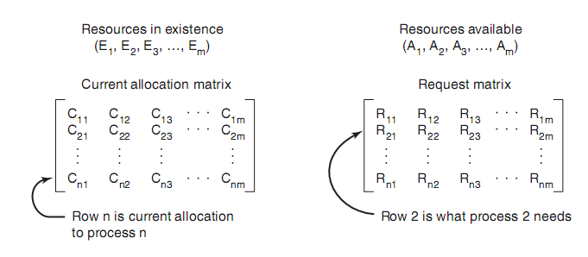
Operating Systems & Systems Programming
Deadlock
These four data structures are shown in Figure below:
Figure: The four data structures needed by the deadlock detection algorithm.

Slide 19
Operating Systems & Systems Programming
Deadlock
The deadlock detection algorithm is based on comparing vectors. Let us define the relation A ≤ B on two vectors A and B to mean that each element of A is less than or equal to the corresponding element of B. Mathematically, A ≤ B holds if and only if A_{i} ≤ B_{i} for 1 ≤ i ≤ m.
Each process is initially said to be unmarked. As the algorithm progresses, processes will be marked, indicating that they are able to complete and are thus not deadlocked. When the algorithm terminates, any unmarked processes are known to be deadlocked. This algorithm assumes a worst-case scenario: all processes keep all acquired resources until they exit.

Slide 20
Operating Systems & Systems Programming
Deadlock
The deadlock detection algorithm can now be given as follows.
1. Look for an unmarked process, P_{i} , for which the ith row of R is less than or equal to A.
2. If such a process is found, add the ith row of C to A, mark the process, and go back to step 1.
3. If no such process exists, the algorithm terminates.
When the algorithm finishes, all the unmarked processes, if any, are deadlocked.

Slide 21
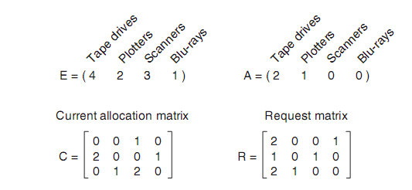
Operating Systems & Systems Programming
Deadlock
Figure: An example for the deadlock detection algorithm ( No deadlock)

Slide 22
Operating Systems & Systems Programming
Deadlock
Now consider a minor variation of the situation of Figure.
Suppose that process 3 needs a Blu-ray drive as well as the two tape drives and the plotter. None of the requests can be satisfied, so the entire system will eventually be deadlocked. Even if we give process 3 its two tape drives and one plotter, the system deadlocks when it requests the Blu-ray drive.

Slide 23
Operating Systems & Systems Programming
Deadlock
Recovery from Deadlock
Recovery through Preemption
Recovery through Rollback
Recovery through Killing Processes

Slide 24
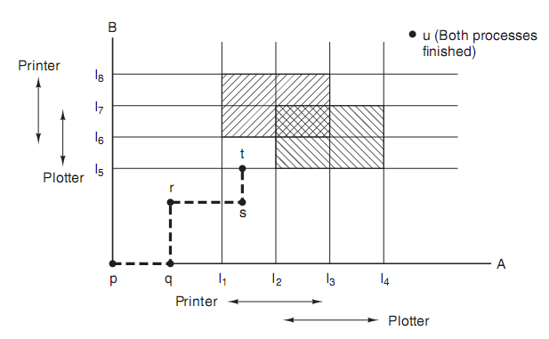
Operating Systems & Systems Programming
Deadlock
Deadlock Avoidance
Resource Trajectories
Figure : Two process resource trajectories.

Slide 25
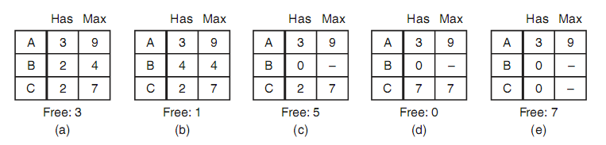
Operating Systems & Systems Programming
Deadlock
Safe and Unsafe States
A state is said to be safe if there is some scheduling order in which every process can run to completion even if all of them suddenly request their maximum number of resources immediately.
Example
Figure : Demonstration that the state in (a) is safe.

Slide 26
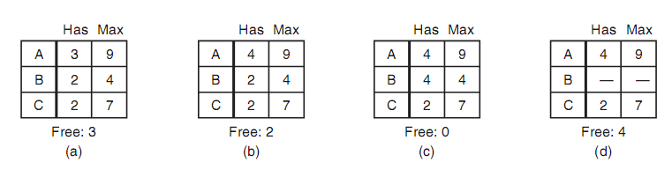
Operating Systems & Systems Programming
Deadlock
Example
Figure : Demonstration that the state in (b) is not safe.

Slide 27
Operating Systems & Systems Programming
Deadlock
Deadlock Prevention
Attacking the Mutual Exclusion Condition
Attacking the Hold and Wait Condition
Attacking the No Preemption Condition
Attacking the Circular Wait Condition

Slide 28
Operating Systems & Systems Programming
Deadlock
Deadlock Prevention
Mutual Exclusion
Shared resources such as read-only files do not lead to deadlocks.
Unfortunately some resources, such as printers and tape drives, require exclusive access by a single process.

Slide 29
Operating Systems & Systems Programming
Deadlock
Deadlock Prevention
Hold and Wait
To prevent this condition processes must be prevented from holding one or more resources while simultaneously waiting for one or more others. There are several possibilities for this:
Require that all processes request all resources at one time. This can be wasteful of system resources if a process needs one resource early in its execution and doesn't need some other resource until much later.

Slide 30
Operating Systems & Systems Programming
Deadlock
Deadlock Prevention
Hold and Wait
Require that processes holding resources must release them before requesting new resources, and then re-acquire the released resources along with the new ones in a single new request. This can be a problem if a process has partially completed an operation using a resource and then fails to get it re-allocated after releasing it.

Slide 31
Operating Systems & Systems Programming
Deadlock
Deadlock Prevention
No Preemption
Preemption of process resource allocations can prevent this condition of deadlocks, when it is possible.
One approach is that if a process is forced to wait when requesting a new resource, then all other resources previously held by this process are implicitly released, ( preempted ), forcing this process to re-acquire the old resources along with the new resources in a single request, similar to the previous discussion.

Slide 32
Operating Systems & Systems Programming
Deadlock
Deadlock Prevention
No Preemption
Another approach is that when a resource is requested and not available, then the system looks to see what other processes currently have those resources and are themselves blocked waiting for some other resource. If such a process is found, then some of their resources may get preempted and added to the list of resources for which the process is waiting.

Slide 33
Operating Systems & Systems Programming
Deadlock
Deadlock Prevention
Circular Wait
One way to avoid circular wait is to number all resources, and to require that processes request resources only in strictly increasing ( or decreasing ) order.
In other words, in order to request resource Rj, a process must first release all Ri such that i >= j.
One big challenge in this scheme is determining the relative ordering of the different resources

Slide 34
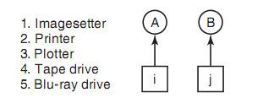
Operating Systems & Systems Programming
Deadlock
Deadlock Prevention
Circular Wait
One way to avoid the circular wait is to provide a global numbering of all the resources. Now the rule is this: processes can request resources whenever they want to, but all requests must be made in numerical order.
A process may request first a printer and then a tape drive, but it may not request first a plotter and then a printer.

